Slide 1
“PORTFOLIO”
Task - 4

Slide 2
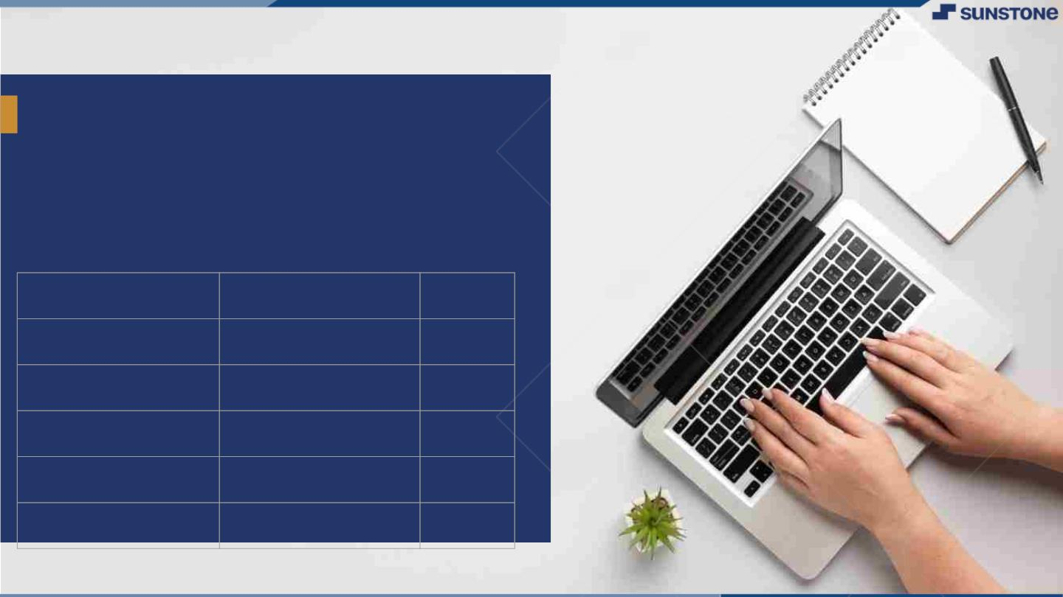

PORTFOLIO
Add a portfolio is a collection of financial assets, investments, or securities held by an individual,
institution, or entity. These assets can include stocks, bonds, mutual funds, real estate, cash, and
other financial instruments. The primary purpose of a portfolio is to help an investor achieve their
financial goals by diversifying their holdings and managing risk.
little bit of body text.
▪
LMS Username | Name | Batch
 | D.Boobala Muralitharan | NM_2.0_CF12_9
au813820104096 | SHALINI A | NM_2.0_CF12_9
au813820104102 | SNEHA M | NM_2.0_CF12_9
au813820104103 | SONALAKSHME S | NM_2.0_CF12_9
au813820104087 | PRIYA DHARSHINI P | NM_2.0_CF12_9
LMS Username
Name
Batch

Slide 3
Task 4 : Dynamic Frontend
Integrate the APIs to frontend to ensure the dynamic feature of website
Point base API to the severs base url
Design API calls for each element
Handle errors in the output
Render output of apis to different low level components
Secure content of post apis
Evaluation Metric:
100% Completion of the above tasks
Learning outcome
Developing complicated UI using HTML components
Using props drilling and context to pass variables
Getting familiar with different type of api calls
Handling different input data

Slide 4
Step-Wise Description
Step 1: Set Up MongoDB
Install MongoDB atlas and create a new MongoDB cluster for Todo and define collections such as add and delete.
Step 2: Backend Technology
Choose Node.js with the Express.js framework for your backend development.
Initialize a new Node.js project and install necessary packages, including express, mongoose (for MongoDB), and other dependencies.
Step 3: Define Database Schema : Define Mongoose models for each entity in the database schema and link the models.
Step 4: Set Up Express Routes: Create routes for each API endpoint in your Express application. Implement CRUD operations using Mongoose methods within your route handlers. Use Mongoose schema validation or other validation libraries to ensure data integrity.
Step 5: Category APIs: Create APIs for managing product categories.
Step 6: Security Input Validation: Ensure input validation in both the schema and route handlers
Summary of your task
Set up a MongoDB database, define Mongoose models for entities like add and delete, and implement CRUD APIs using Node.js with Express for a Bloghub. Ensure proper data validation, implement additional APIs for categories and user authentication, and deploy the backend to a hosting service. Integrate the backend with the frontend, testing the integrated system for smooth communication.

Slide 5
Assessment Parameter
Design Schema for data to be stored such as
added tasks and deleted tasks.
Point all routes with a appropriate controllers to control request and response
Set mongodb server on atlas
PORTFOLIO
Task updates when user upload tasks and delete from list when user deletes it.
Add dummy data with schema in mongodb server.
Filter and sanitize all the incoming data in http requests
Run some test queries to test the server
Set up secure environment variables for secret keys

Slide 6
Submission Github
https://github.com/Sneha364-M/fullstack-portfolio
https://github.com/Shaliniarul/project
https://github.com/Sonalakshme22/portfolio
https://github.com/PriyaJenny/FS

Slide 7


